Slide 1
Claude Code
M. Caldwell
4-30-26

Slide 2
Welcome
Today’s goals:
See what a specialized LLM like Claude code can do.
Understand the power of context.
Explore how complex applications can be built using a good workflow and layering goals.
We will also look at the Claude interface and walk through the interface.

Slide 3
Claude Code and You

Slide 4
Disclaimers ***
You must have at least a pro subscription to Claude ($17/mo)
There is a limit to requests per 5 hr window and per week.
I have some configurations in the background that I don’t have time to cover. If you want more details we can do another session.
While this is awesome it’s still has… bugs... The more you know about programing and a language the easier it gets to build and debug.
There is NO complete guidance on the ethics or use of this from the university.
There is no single point of support or licensing from the university. (thanks Mike E and Ram for this opportunity).

Slide 5
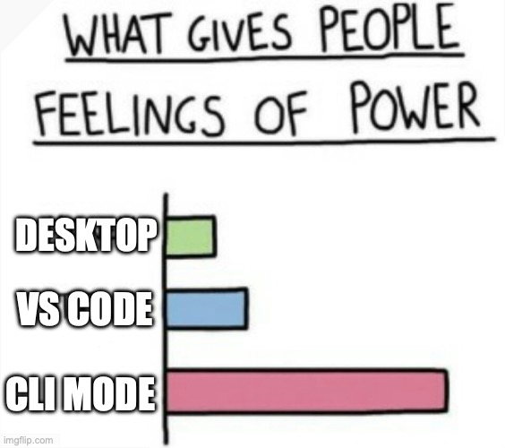
Flavors of Claude
There are a bunch of different ways to use Claude code.
Native in VS code or Visual studio.
In a Command Line Interface (CLI).
In the Claude desktop app.
Through GitHub.
The Desktop app is an easy to use and fully functional “IDE” for the non-hardcore.

Slide 6
Homework (yes this is a thing)
During this presentation look for two ways that you might be able to use Claude code.
Research.
Class artifacts.
Tools to help you at work.
Personal applications.
Make a note for later, we’ll share with the class… if there's time.

Slide 7
What is Claude Code

Slide 8
General LLM vs. Specialized LLM
General LLM
e.g. Base GPT, Gemini
Specialized LLM
e.g. Claude Code by Anthropic
Broad knowledge coverage
Trained on general internet data
One-size-fits-all responses
No domain customization
Inconsistent tone & style
Varies across topics and tasks
No task specialization
Mediocre at deep domain tasks
Minimal safety tuning
Generic guardrails only
Deep domain expertise
Fine-tuned for specific use cases
Consistent voice & tone
Aligned to brand or task persona
Task-optimized reasoning
Excels at coding, analysis, writing
Constitutional AI safety
Helpful, harmless, and honest
Context-aware responses
Understands nuance and intent
VS

Slide 9
Our First Project
Writing “basic” code for a class project.
Prompt 1:
“I would like you to build a file I can compile for my MSP-430 that has an LED as an output. The led will have a heartbeat type fade, the period and rate will be controlled by two potentiometers”
This is an example of a basic prompt, there little specifics and no instructions on how to build this or what it’s for.
We’ll build a better prompt later

Slide 10
How Claude Code Understands Context
CONTEXT WINDOW
Relevant Project Data
Files, code, docs in your project
Project Data
+
Claude
Code
Smart
Response
with full context
Prior Conversation
Everything said earlier in the session
Prior Chat
+
Your Prompt
Your Prompt
What you are asking right now
Context is not just your message — it is everything Claude knows about your work at that moment.

Slide 11
Project 2
Create a class artifact to share.
Prompt 2:
“I’m a teacher and I want to produce an active demo as an HTML file for my dynamics and vibrations class. I would like this file to show how a spring mass damper acts after an impulse. Let’s assume that this is a horizontal system where damping is modeled as friction. I want to show the general 2nd order transfer function relating force to distance at the top, then maybe sliders to adjust the coefficients, then the specific transfer function. Below that should be two plots, one that shows the time constant and one that shows the time domain response. Pick appropriate axis and scales. I’ve included a calculations document for reference I want the aesthetic to mimic an early 2000’s webpage for a vintage feel, I’ve included a style document that a UI/UX expert can use to build the page.”

Slide 12
Claude Code: Agentic Workflow
01 PLAN
02 BUILD
03 TEST
Orchestrator Plans
Specialized Agents Build
Agents Verify & Test
Research Agent
Gathers requirements
& existing code patterns
Code Agent
Writes core logic
& business rules
Unit Test Agent
Tests individual
functions & modules
Architecture Agent
Designs system structure
& component map
UI Agent
Builds interfaces
& user flows
Integration Agent
Validates cross-service
behaviour
Dependency Agent
Maps libraries, APIs
& data flows
API Agent
Connects services
& integrations
QA Agent
End-to-end checks
& edge cases

Slide 13
Building with Claude: Layer by Layer
Scale and Deploy
Testing
How Claude Builds in Layers
●
Core
Claude defines the minimal working product: core data models, basic logic, primary user action.
Feature(s)
1
Feature(s)
Make this your functional goals, what would you want for personal use? What would make this cool or stand out ?
Core
2
Testing
Claude builds test scripts that look for edge cases, test installations, and inspects code.
4
Scale & Polish
Final agents handle perf tuning, error handling, logging, and deployment pipelines(GitHub).
Each layer is independently planned, built, and tested by Claude agents — so the foundation is always solid.

Slide 14
Project 3
Add on to a functional web application for work.
Prompt 3:
Look at where we left off with this project, I want to plan to add a feature. When a student flags a class as complete, we should ask that students provide their grade in the course as a standard letter grade with this and with the number of credits from the course plan document we need to, first update a “GPA” tracker bar at the bottom of the screen and second calculate the letter grade that the student received. Second before marking this class as complete check to see if the student met the minimum grade requirement in their plan. Make sure to consider an edge case where this isn’t listed and defaults to a D or greater. I’d like the grade entry window to be a model popup that uses the same style set as the application. Grade policy can be found here https://www.rit.edu/policies/d050 . Once we’ve updated our plan document let’s execute an elite coding agent and a UI/UX agent as needed to build the feature. “
/btw I’ve added a sample plan MECA_TEST_PLAN.csv in the doc’s folder so that you can do some basic testing.

Slide 15
Use Cases
What are some use cases that you might have for Claude?
What questions do you have about workflows or Claude Code in general?
Would you like a second session on this or other AI topics?

